Slide 1
Homelessness in the us
Group #5

Slide 2


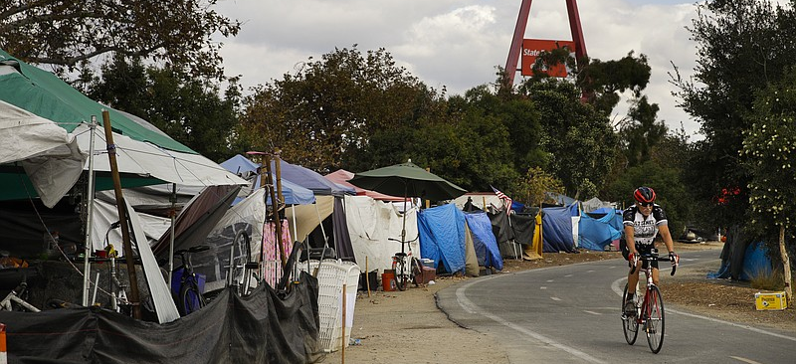
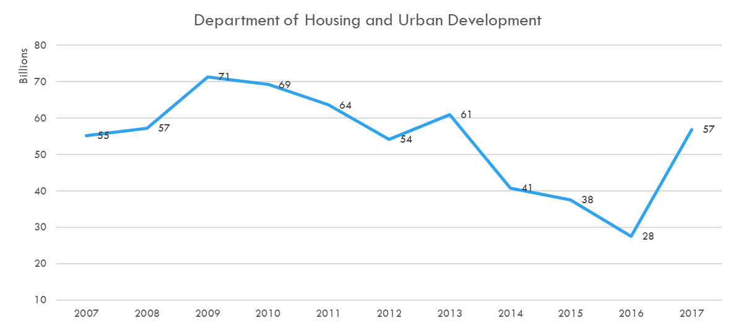
Motivation
With rising housing prices, increasing gentrification of neighborhoods, and rent disrupting apps like Airbnb, Homelessness has become one of the biggest issues in the us. we can see the issue has alarmed the federal government when they increased Hud’s budget by 29 billion dollars in 2017 (Federal Budget).
For our project, we’d like to explore how the homeless population has changed over the past decade and what factors may impact homelessness trends in the us.

Slide 3
Questions to explore
HOW Has the homeless population changed in the past decade?
IS THERE A CORRELCATION BETWEEN MEDIAN HOUSEHOLD INCOME AND HOMELESS RATE?
Is there a correlation between UMEMPLOYEMENT RATE AND HOMELESS RATE?
IS THERE A CORRELATION BETWEEN POVERTY RATE AND HOMELESS RATE?

Slide 4

approach
Gather Data
Homeless & total population, household income, federal budget, unemployment & poverty
Munge & Merge
Use Python and Pandas to import, clean, join, and export the data
Visualization
Use JavaScript, D3, HTML/CSS, and Flask to visualize the data to analyze possible trends and correlations

Slide 5

Data sources
Homeless population: https://www.hudexchange.info/resource/3031/pit-and-hic-data-since-2007/
State population: https://www.census.gov/data/tables/time-series/demo/popest/2010s-state-total.html
American Fact Finder: https://factfinder.census.gov/faces/nav/jsf/pages/searchresults.xhtml
Federal Budget: https://data.world/throwback-thurs/throwbackdatathursday-week-13-us-federal-budget-1962-2018

Slide 6
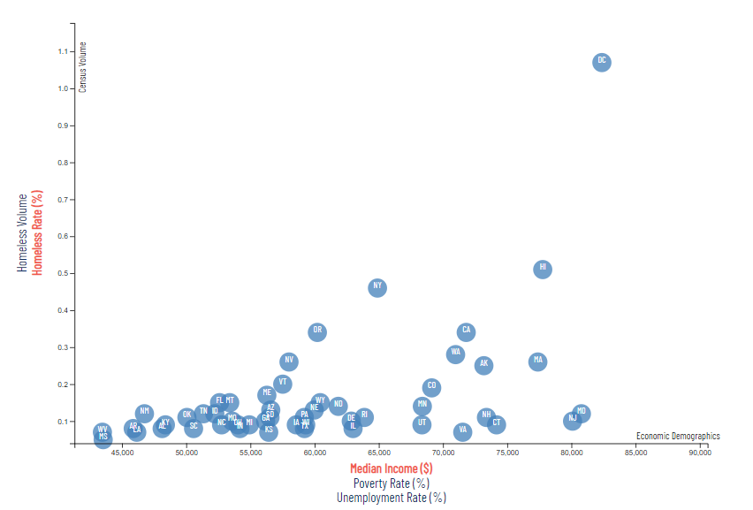
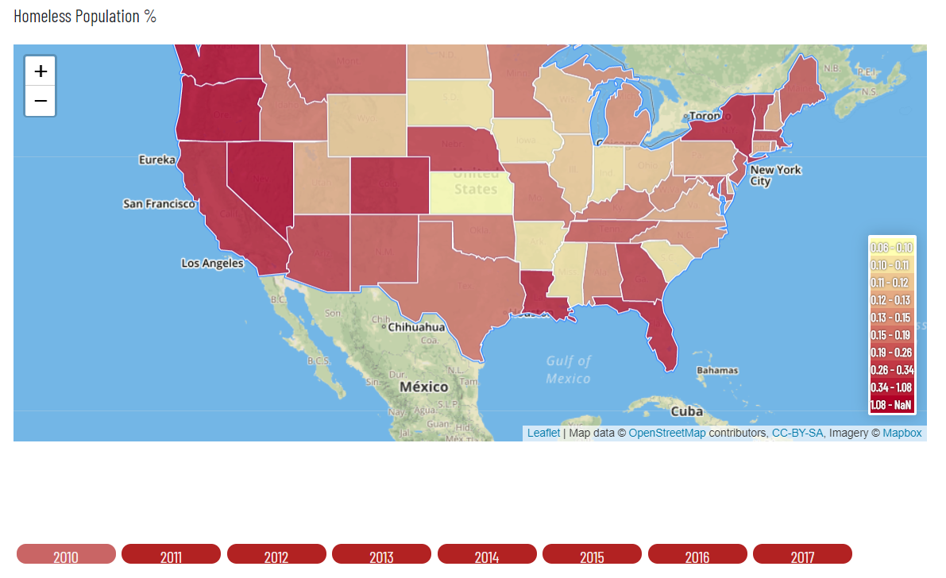
visualizations
Created an interactive online dashboard showing us state homeless population trends from 2010 to 2017.
Our dashboard includes
Line graph (D3):
Homeless population % of total population by state
Scatter plot (d3):
Dimensions: median household income, poverty rate, unemployment rate
Map (Leaftlet):
Filter: year
Heatmap: homeless population

Slide 7

WHAT DID WE FIND?

Slide 8
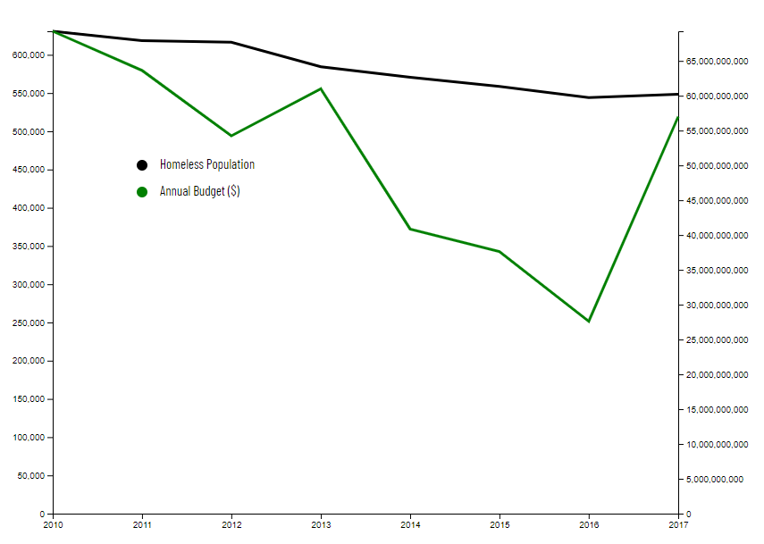
Homeless population % of state population (2010 – 2017)
CONTRARY TO HUD’S BUDGET INCREASE IN 2017 (AND OUR ANECDOTAL EXERIENCE IN CALIFORNIA), NATIONWIDE, OUR HOMELESS POPULATION HAS ACTUALLY DECREASED FROM 2010 – 2017.

Slide 9
Homeless population % of state population (2010 – 2017)
While the overall national homeless population has seen a downtrend, California saw a sharp fall and rise between 2011 to 2017. California voter responded to this by passing proposition 1 which allocated 4 billion dollars to address homelessness in the state CA ELECTION RESULTS.

Slide 10
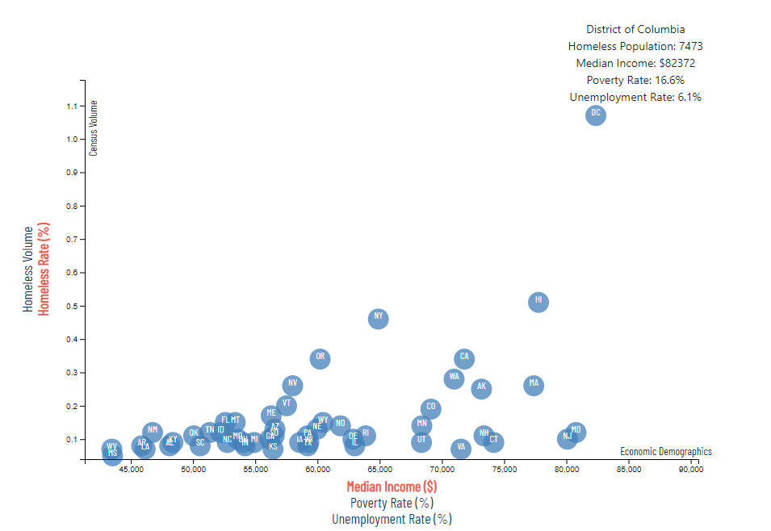
Despite having the highest median household income, Washington DC holds the highest concentration of homeless individuals within their population at 1.07%. With such a high median income, more households are likely to fall under the poverty line, which hold just under 17% of their total population. This is also compounded by their unemployment rate of 6.1%, which is the second highest in the nation.

Slide 11
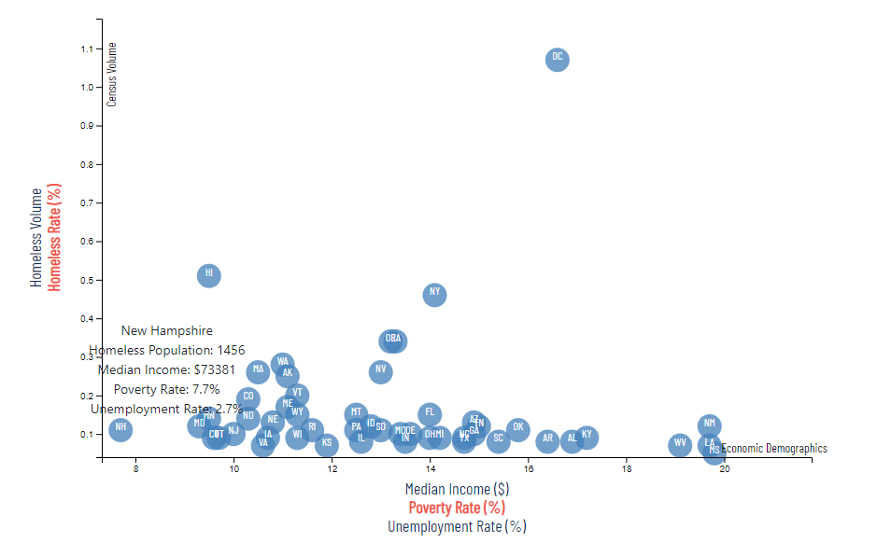
Conversely, New Hampshire is on the opposite end of the homeless population spectrum. With the lowest poverty rate in the nation and a rate of unemployment second only to Hawaii, we can use these economic indicators to establish New Hampshire as the state with the lowest homeless population rate in the United States.

Slide 12
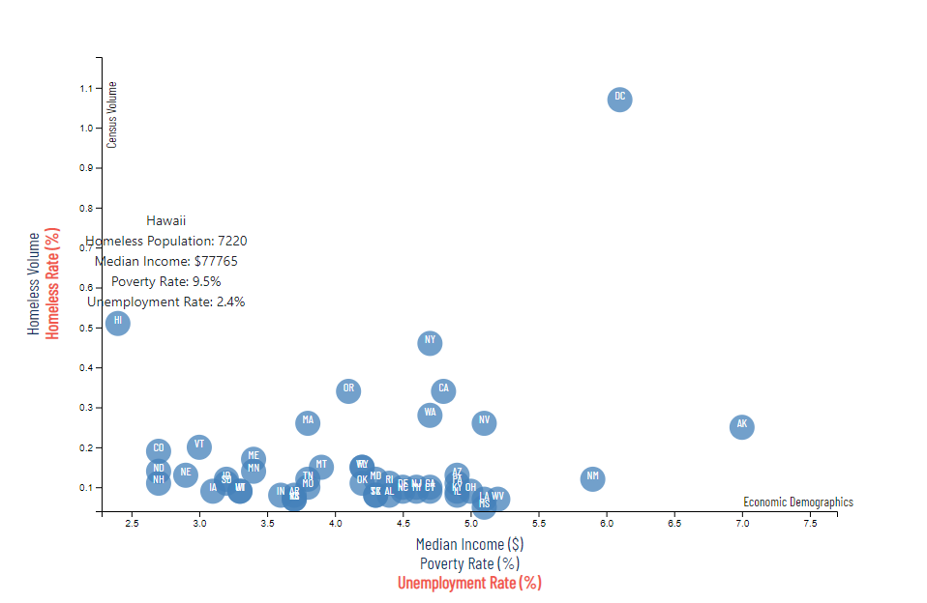
One anomaly we uncovered throughout this analysis were the metrics related to Hawaii. Although the state boasts the lowest rate of unemployment in the nation and one of the lowest poverty rates, they hold the second highest concentration of homeless individuals within their population with a rate of 0.51%.

Slide 13

conclusion
Nationwide, we’ve seen a downtrend in our homeless population in the past decade. However, D.C., Hawaii, California, and New York are bucking the national trend. We’d like to explore further what factors are driving these trends.
Since we did not see any major changes in homeless population from 2010 – 2017, we’d like to expand our dataset to see if there are any major changes over the past 25 – 50 years.

Slide 14
Challenges
Visualization complexity & coordination
file/folder Relationship complexity: so many files! “where do I put my files?!”
Flask: first time consolidating multiple routes & pages
Adapting when overall data shows no changes
Added household income, poverty, and unemployment rates
Updating Geojson is the worst!

